Slide 1
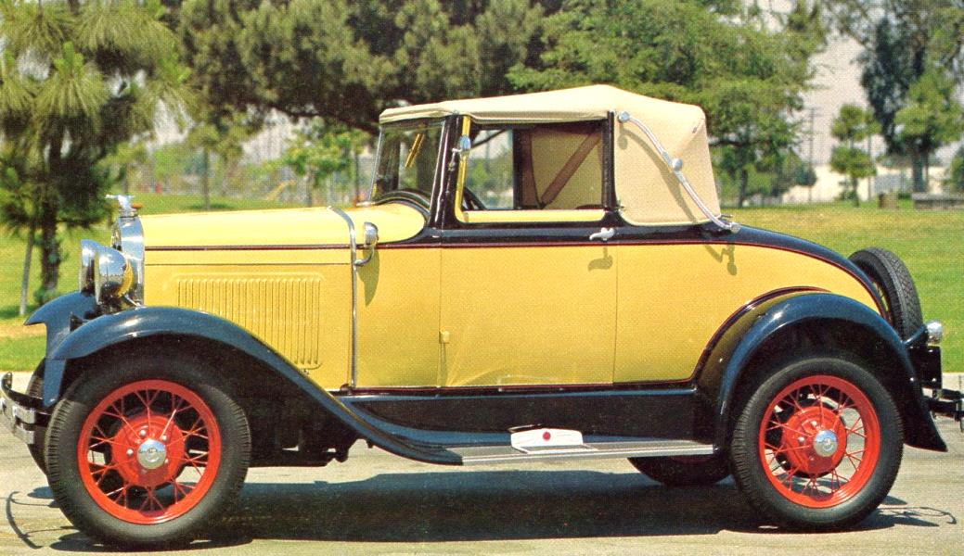
What is My Car Worth?
By Bob Travis

Slide 2
Exactly what someone will pay for it. ( A Travis Truism)

Slide 3
Factors influencing car values:
Body style
Rarity
Year 1928-29 vs 1930-31
Condition
Unique Features
Standard vs Deluxe

Slide 4
Price Range
Low - under $10 K
Medium - $10 to 25 K
High - $25 K up
Basket Case – Project Car
Older Restoration – Original Car
New Restoration – Rare Model

Slide 5
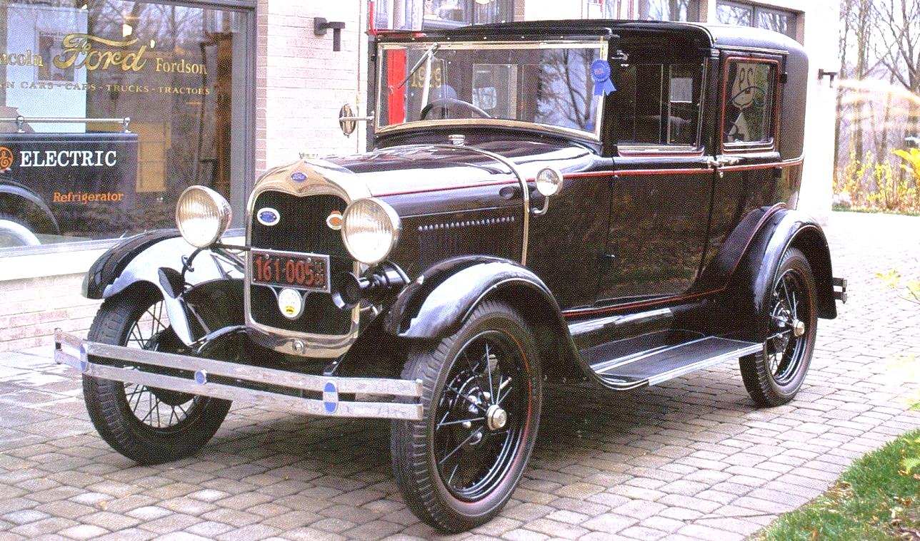
1928 - 1929 Town Car
New - $1200
Very Rare. 89 Produced in 1928.
913 Produced in 1929
Current Est. Price: No pricing guide available.

Slide 6
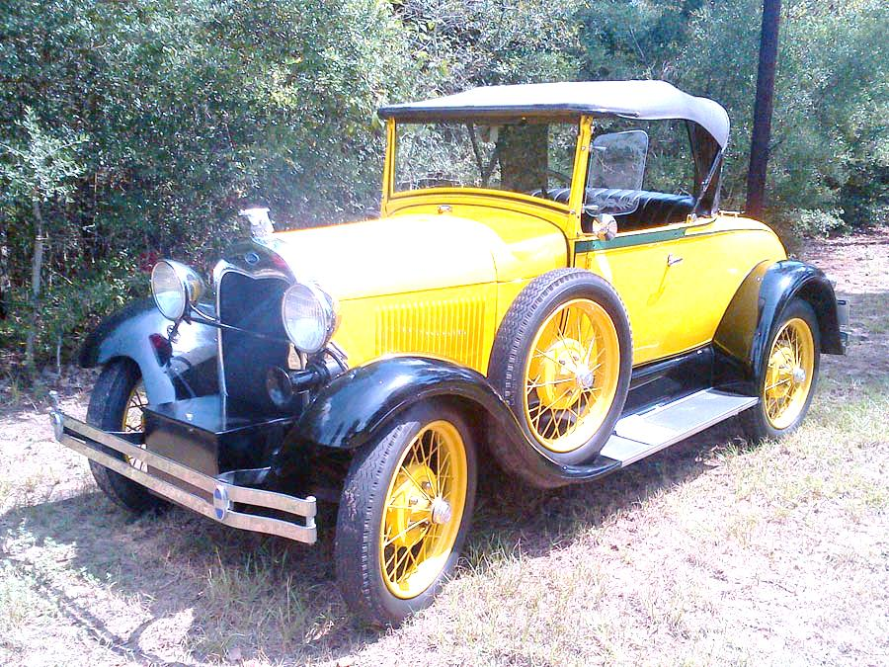
1928 - 1929 Roadster
New - $385 to 435
Current Est. Price:
Low - 8K to 10K
Medium - 10K to 14K
High - 14K to 18K
No Deluxe Models Produced
1928 AR Models Worth More

Slide 7
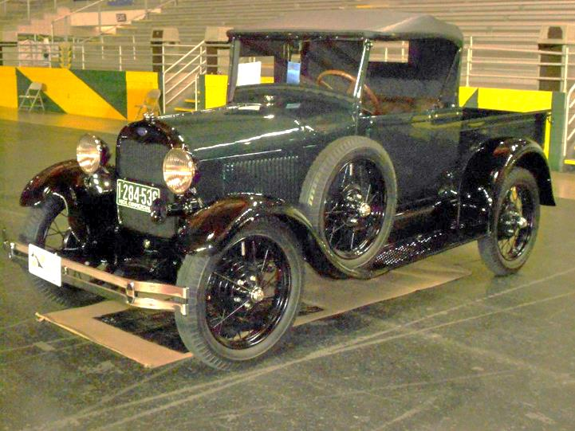
1928 - 1929 Roadster Pickup
New - $395 to 440
Current Est. Price:
Low - 8K
Medium - 8K to 14K
High - 14K to 18K

Slide 8
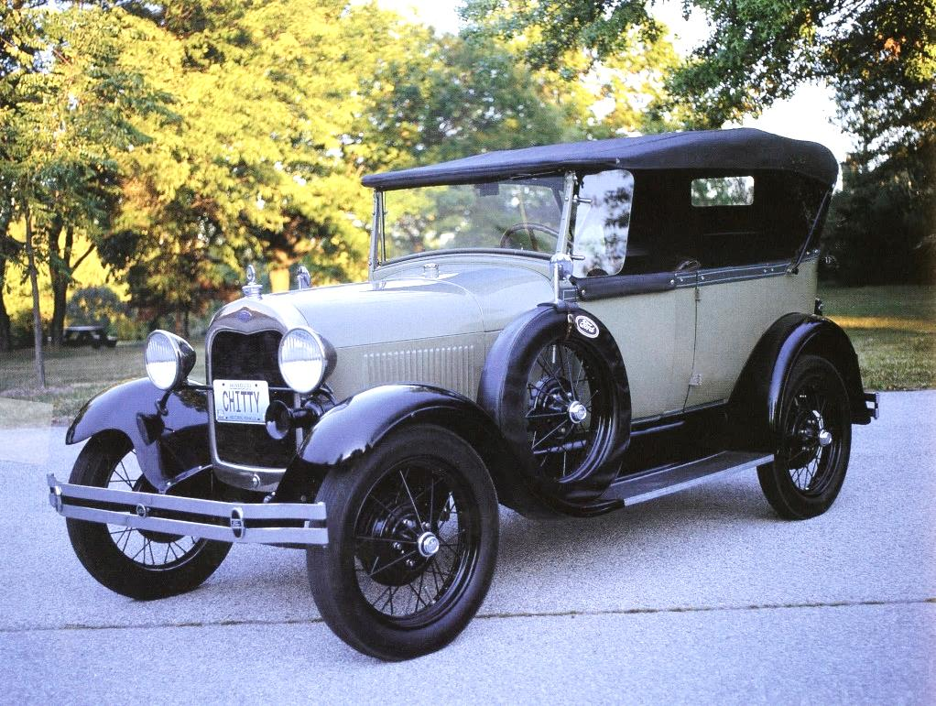
1928 - 1929
4 Door Phaeton
New - $395 to 440
Current Est. Price:
Low - 8K
Medium - 8K to 14K
High - 14K to 18K

Slide 9
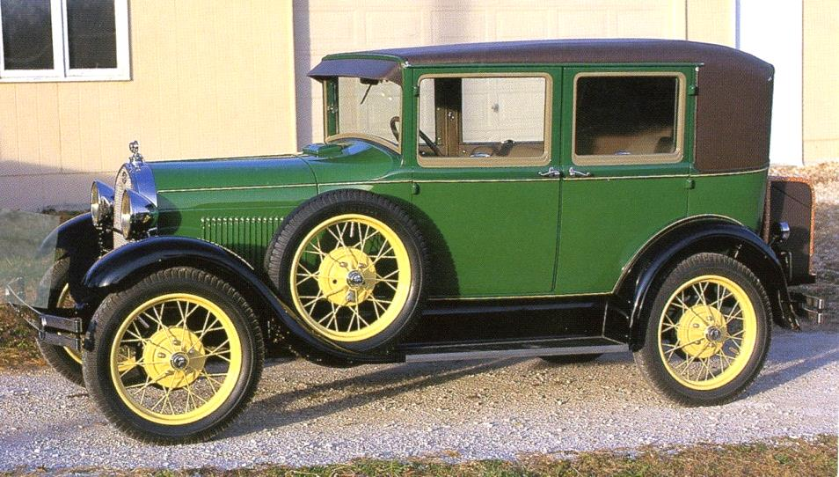
1928 - 1929
4 Door Sedan
New - $570 to 600
Current Est. Price:
Low - 8K to 10K
Medium - 10K to 19K
High - 18K to 22K
Produced as:
Leather Back (Brown & Black), Steel Back,
Town Sedan, Fordor Sedan (3 Window)
Fordor Sedan (2 Window)

Slide 10
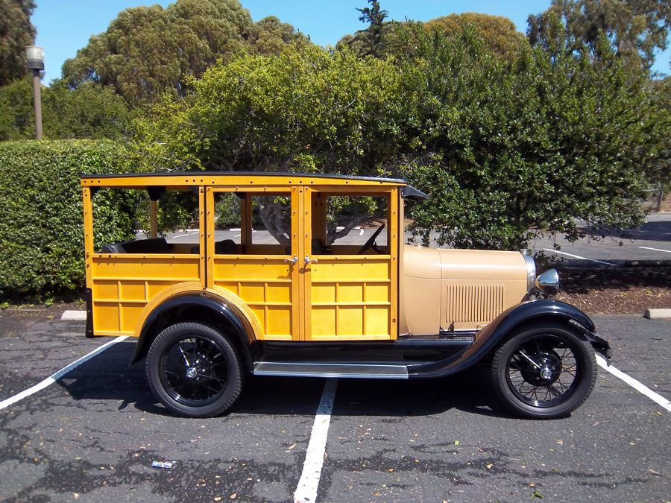
1928 - 1929
Station Wagon
New - $600
Current Est. Price:
Low - 10K
Medium - 10K to 18K
High - 18K to 25K
Only 5 Built in 1928

Slide 11
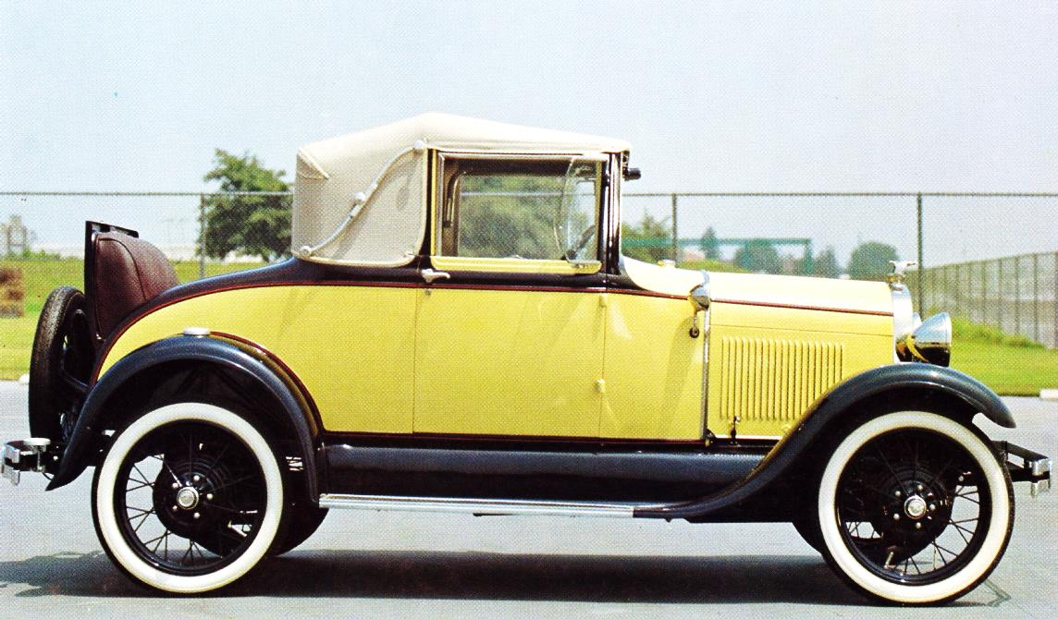
1928 - 1929
Cabriolet
New - $645
Current Est. Price:
Low - 10K
Medium - 10K to 18K
High - 18K to 25K
None Built in 1928

Slide 12
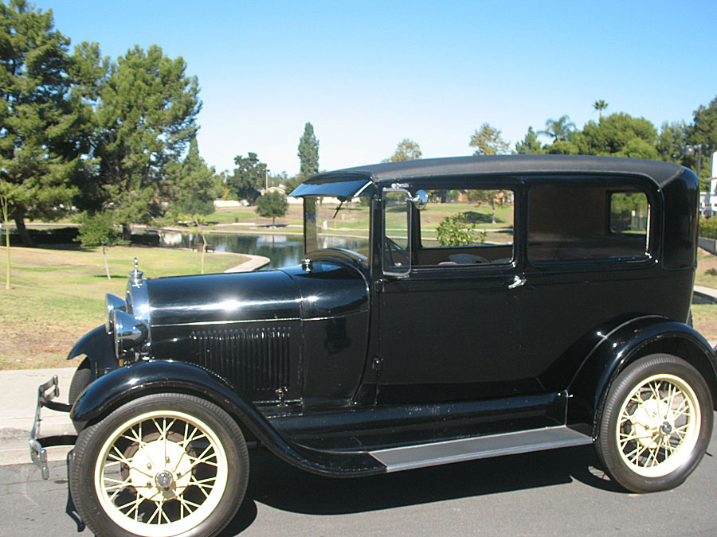
1928 - 1929
Tudor Sedan
New - $495 to 500
Current Est. Price:
Low - 8K
Medium - 8K to 12K
High - 12K to 18K

Slide 13
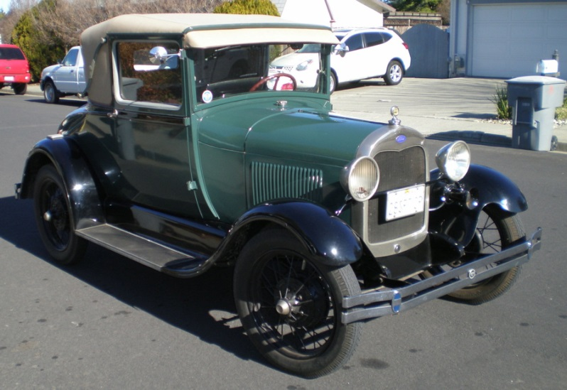
1928 - 1929 Coupe
Standard
New - $495 to 500
Current Est. Price:
Low - 7K to 9K
Medium - 9K to 14K
High - 14K to 18K
Special
New - 500
Current Est. Price:
Low - 7K to 9K
Medium - 9K to 14K
High - 14K to 20K
Sport
New - 550 -530
Current Est. Price:
Low - 7K to 9K
Medium - 9K to 14K
High - 14K to 20K
Business
New - 500
Current Est. Price:
Low - 7K to 9K
Medium - 9K to 14K
High - 14K to 22K
In Production for only
6 Mo. In 1928

Slide 14
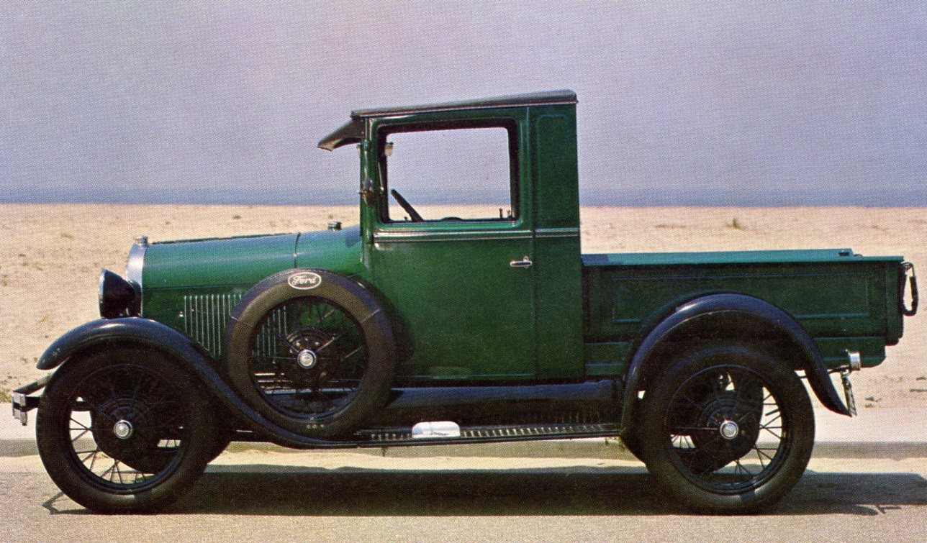
1928 - 1929
Closed Cab
Pickup
New - Current Est. Price:
Low - 5K to 9K
Medium - 9K to 14K
High - 14K to 18K

Slide 15
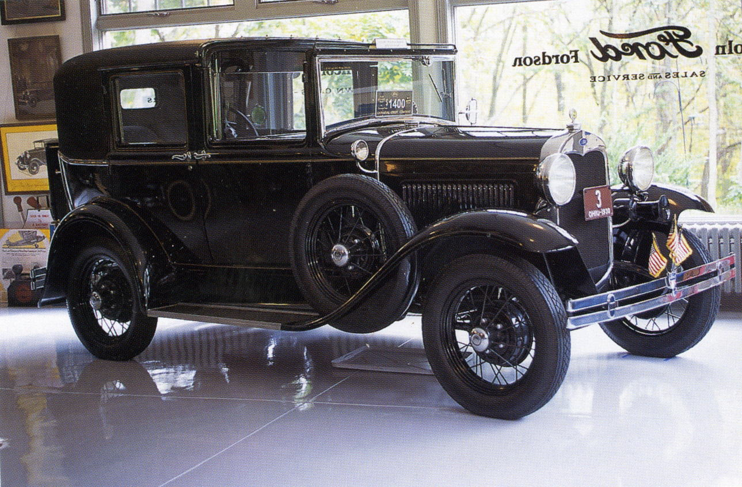
1930 - 1931 Town Car
New - $1200
The rarest of the rare.
Only 63 1930’s were manufactured.
No 1931 cars were produced.
Current Est. Price: No pricing guide available

Slide 16
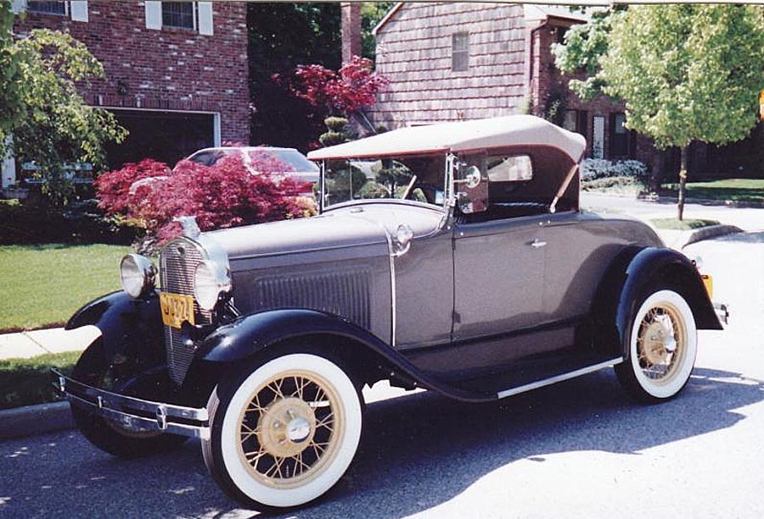
1930 - 1931
Roadster
Standard
New - $450 to 430
Current Est. Price:
Low - 10K to12K
Medium - 12K to 18K
High - 18K to 25K
Deluxe
New - $520 to 475
Current Est. Price:
Low - 10K to 12K
Medium - 12K to 18K
High - 18K to 25K

Slide 17
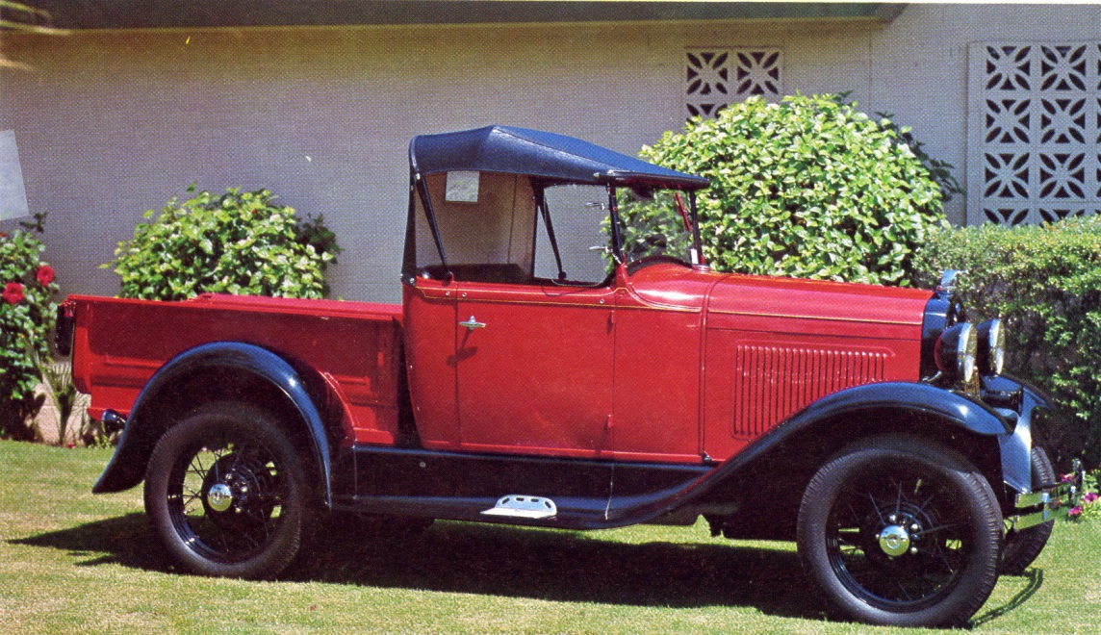
1930 - 1931
Roadster Pickup
New - $495 to 500
Current Est. Price:
Low - 8K to !0K
Medium – 10K to 15K
High - 15K to 22K
Add 1.5K to 2.5K for late 1931 Wide-Bed

Slide 18
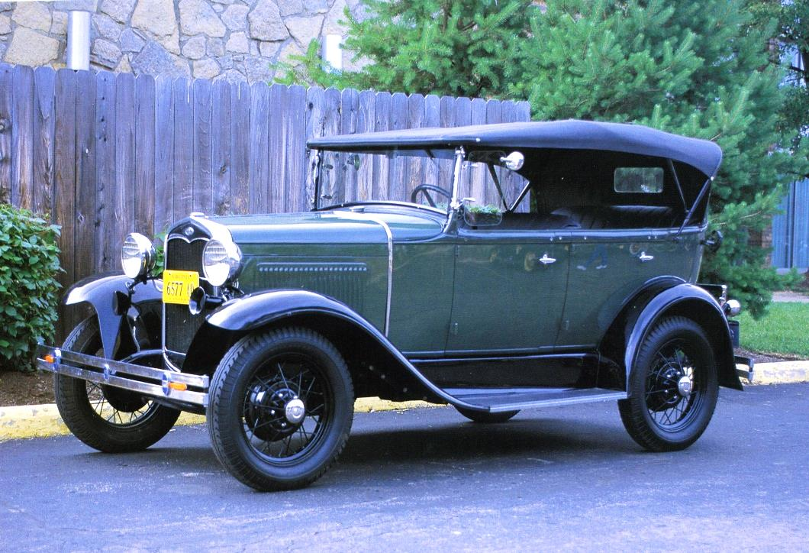
1930 - 1931
Phaeton
Standard 4 Door
New - $440 to 435
Current Est. Price:
Low - 8K to 10K
Medium - 10K to 15K
High - 15K to 20K

Slide 19
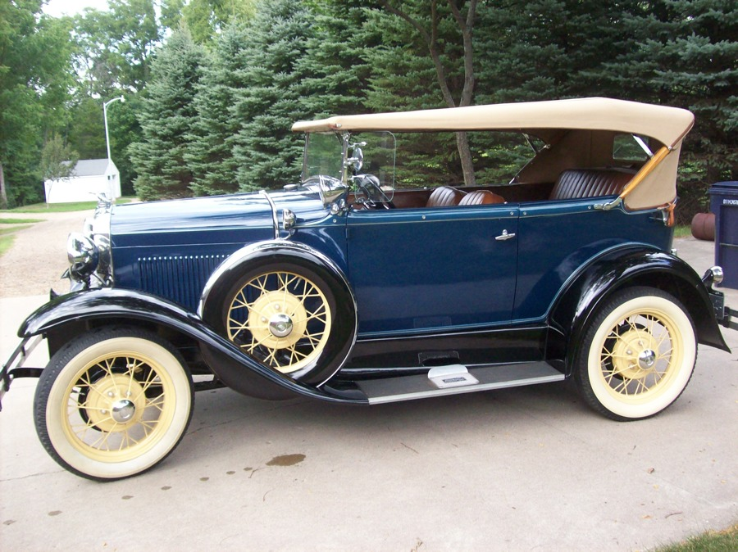
1930 - 1931
Phaeton
Deluxe 2 Door
New - $625 to 580
Current Est. Price:
Low - 15K
Medium - 15K to 35K
High - 35K to 45K

Slide 20
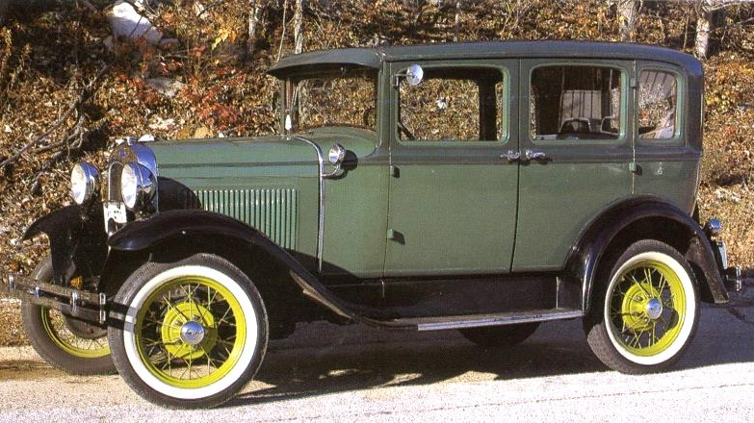
1930 – 1931
Sedan
Straight Window
Standard Sedan
Fordor Sedan
Town Sedan
New - $640 to 630
Current Est. Price:
Low - 10K
Medium - 10K to 18K
High - 18K to 22K

Slide 21
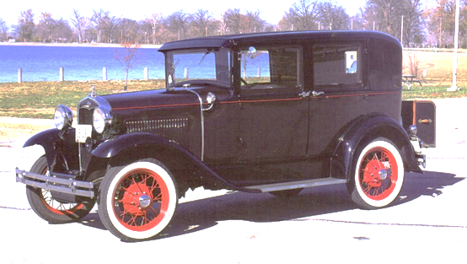
1930 – 1931
Sedan
Straight Window
Fordor Deluxe
2 Window
New - 640 to-630
Current Est. Price:
Low - 10K
Medium - 10K to 18K
High - 18K to 25K

Slide 22
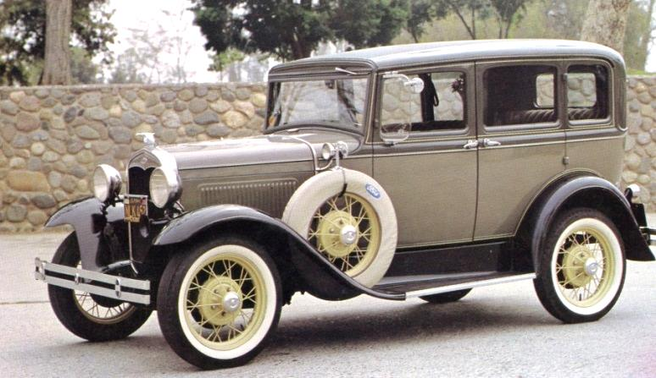
1930 – 1931
Sedan
Slant Window
Standard
New - 600 to 590
Current Est. Price:
Low - 10K
Medium - 10K to 18K
High - 18K to 20K
Town Sedan
New - 630
Current Est. Price:
Low - 10K
Medium - 10K to 18K
High - 18K to 20K
Deluxe 2 Window
New - 640 to-630
Current Est. Price:
Low - 10K
Medium - 10K to 25K
High - 25K to 35K

Slide 23
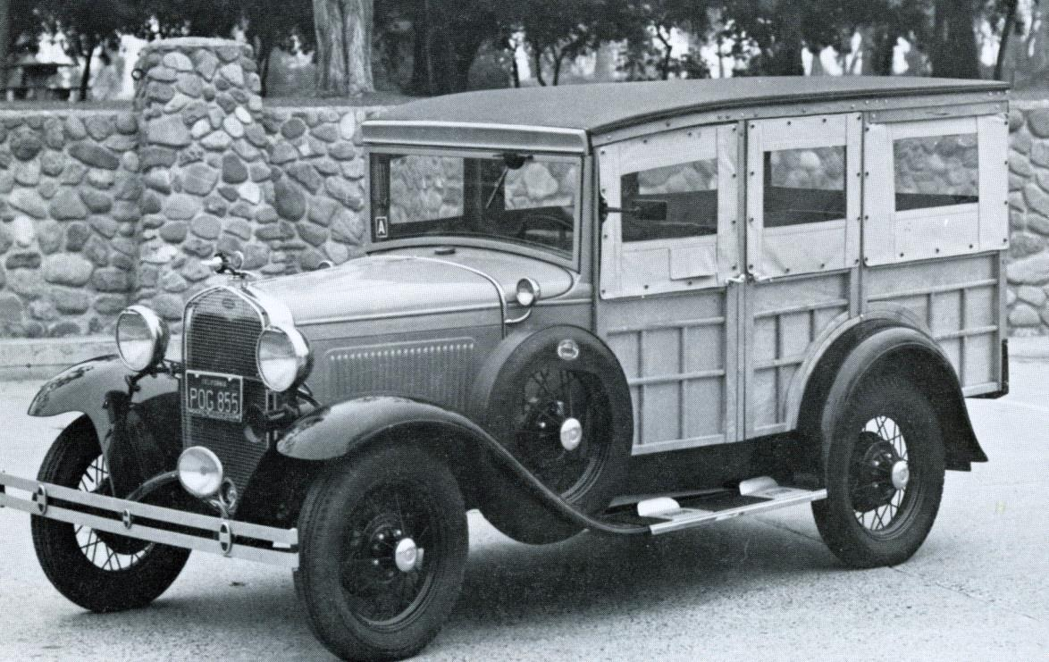
1930 - 1931
Station Wagon
New - $640 to 625
Current Est. Price:
Low - 10K
Medium – 10K to 18K
High - 18K to 25K

Slide 24
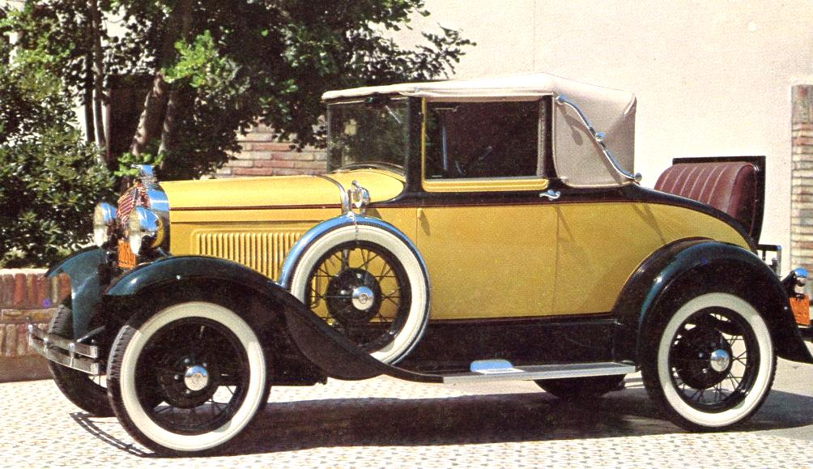
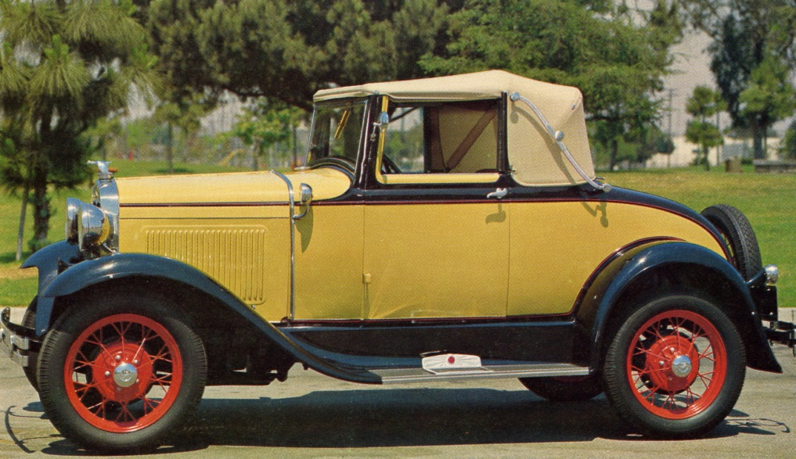
1930 - 1931
Cabriolet
Straight Window
Slant Window
New - $325 to 630
Current Est. Price:
Low - 10K to 12K
Medium – 12K to 18K
High - 18K to 25K
Add 3K to 5K for Slant Window

Slide 25
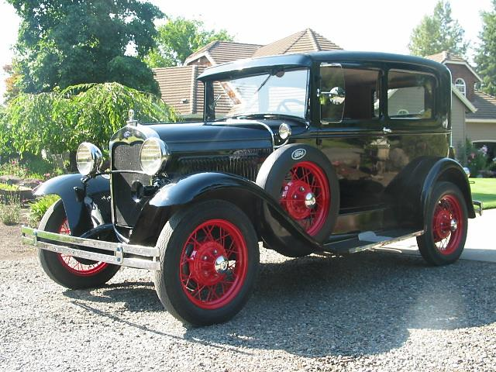
1930 - 1931
Tudor Sedan
New - $495 to 490
Current Est. Price:
Low - 8K
Medium – 8K to 12K
High - 12K to 18K
All 1930 to April 31 were Standard
April 1931 the Deluxe Model was introduced
Add 1.5K to 3 K for Deluxe Model

Slide 26
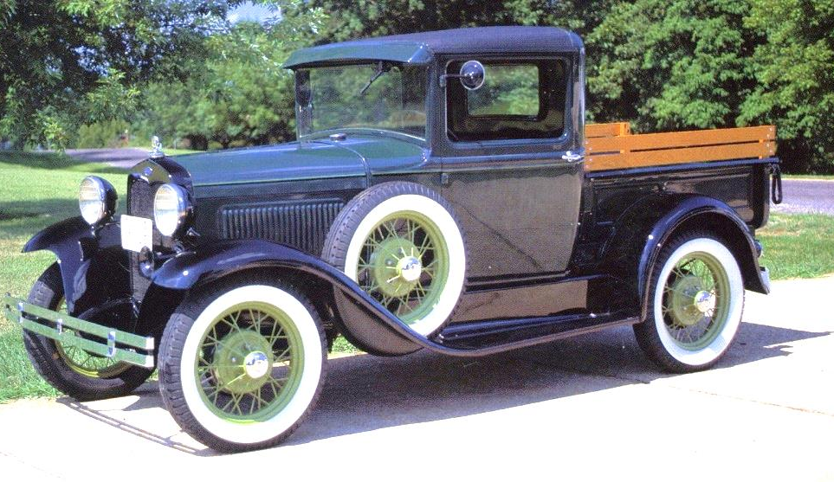
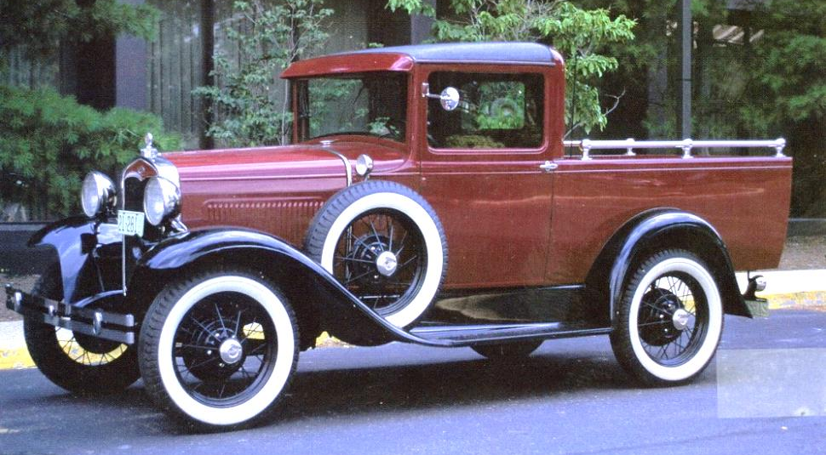
1930 - 1931
Closed Cab
Pickup
New –
Current Est. Price:
Low - 7K – 9K
Medium - 9K to 14K
High - 14K to 18K
Indented fire wall & wide bed after April 1931. Add 1.5K to 3.0K
Steel roof introduced in June 31. Add 1.0K to 1.0K
Deluxe model introduced late 1931. Add 3.5K to 5.0K

Slide 27
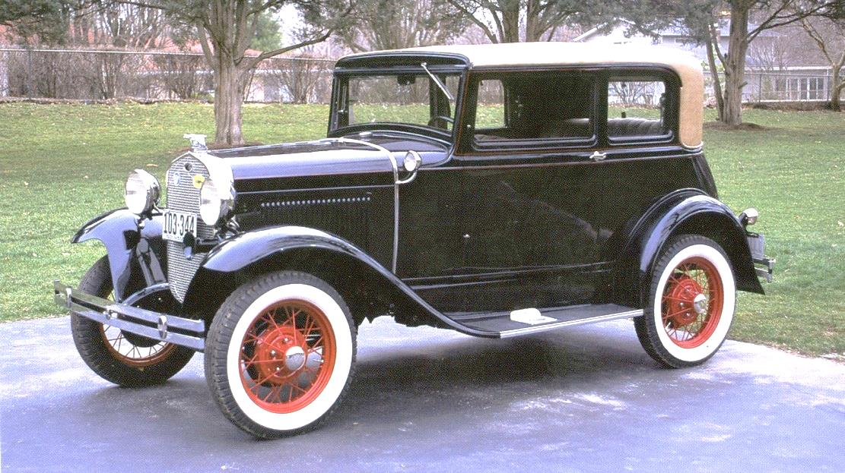
1930 - 1931
Victoria
New - $580
Current Est. Price:
Low - 10K
Medium – 10K to 18K
High - 18K to 25K
Deluxe Model Only

Slide 28
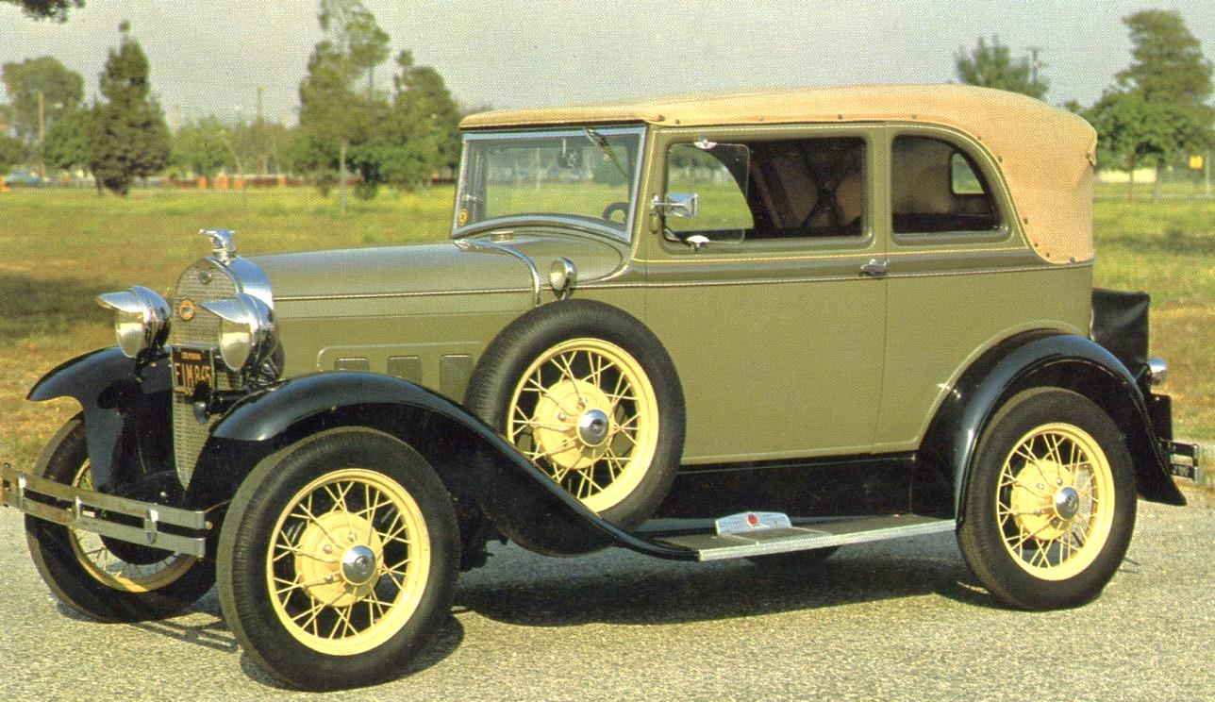
1931 A 400 Convertible
New - $640
Current Est. Price:
Low - 15K
Medium – 25K to 35K
High - 35K up

Slide 29
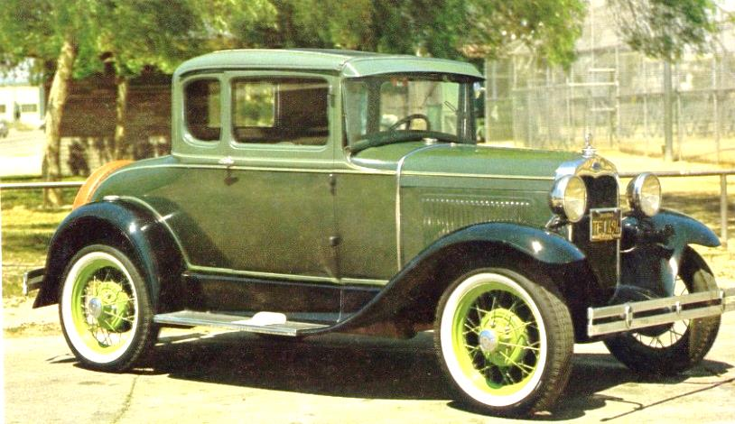
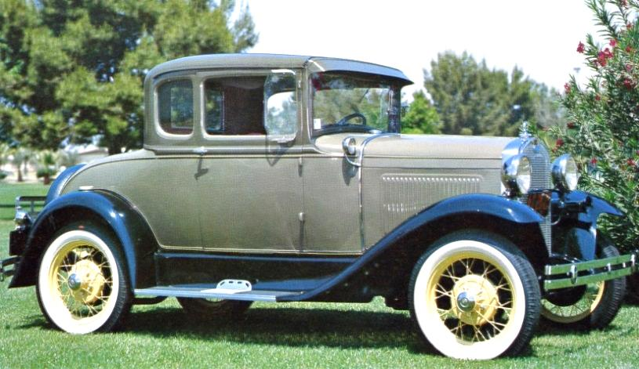
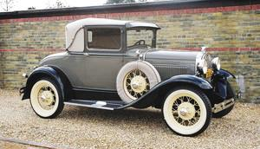
1930 - 1931 Coupe
Standard
New - $495 to 490
Current Est. Price:
Low - 10K
Medium - 10K to 15K
High - 15K to 18K
Deluxe
New - $545 to 525
Current Est. Price:
Add $1.0K to 3.0K
Sport
New - $525 to 500
Current Est. Price:
Add $1.5K to 3.5K

Slide 30
Summary Value is as perceived by owner. Owners should set value for estate purposes. Value should be adjusted with passing time. Consider using an appraiser.

